Slide 1
WellNest : Smart Health & Fitness Companion
BY :
Tamanna
Akalya B
Saloni Dash
Mohammad Saidanima

Slide 2

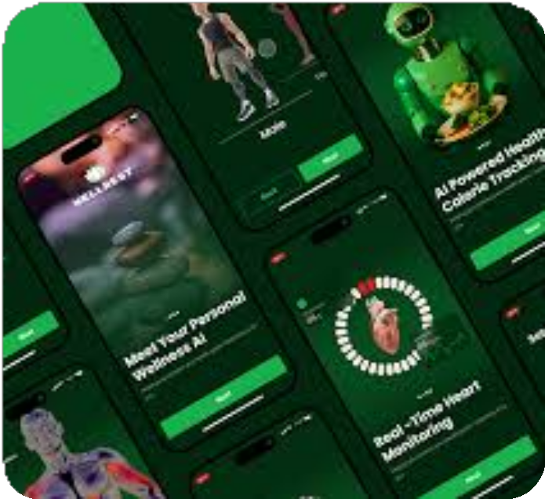
Introduction
In today’s fast-paced lifestyle, maintaining good health has become a major challenge due to irregular routines, poor diet habits, and lack of physical activity. People often find it difficult to consistently track their daily fitness activities such as workouts, meals, water intake, and sleep patterns.
The Smart Health & Fitness Companion (WellNest) is designed to address this problem by providing a single, user-friendly platform to monitor and manage overall health and fitness. The application allows users to record their daily health activities, analyze their progress, and receive personalized fitness recommendations.

Slide 3
Tech Stack
Frontend: HTML, CSS, JavaScript Backend: Java (Spring Boot) Database: MySQL
Authentication: JWT (JSON Web Token)
APIs: Daily Health Tips API
Tools: VS Code / Eclipse, Postman, Git

Slide 4
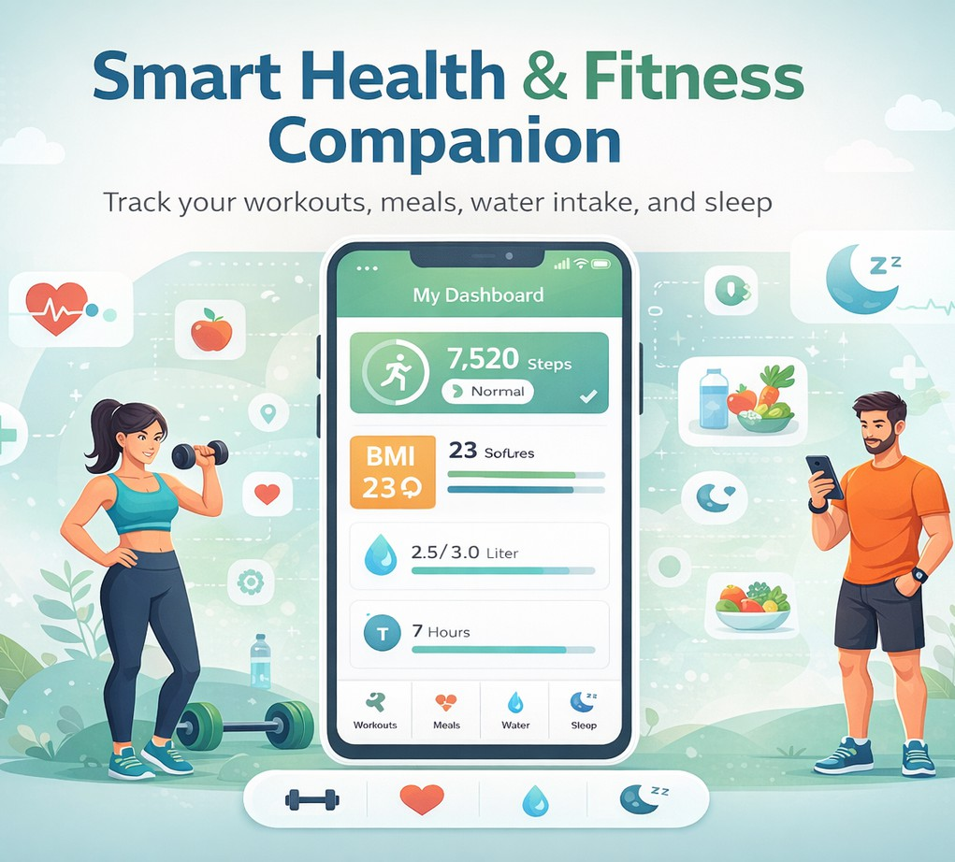
Problem Statement
In today’s busy lifestyle, many individuals struggle to maintain a healthy routine due to lack of proper monitoring and guidance. Fitness activities such as workouts, meal intake, water consumption, and sleep patterns are often tracked inconsistently or not at all. Existing solutions are either fragmented across multiple applications or lack personalized insights and progress analysis.
There is a need for a single, integrated platform that enables users to efficiently track daily health activities, analyze their fitness progress, and receive personalized recommendations to support a healthier and more balanced lifestyle.

Slide 5
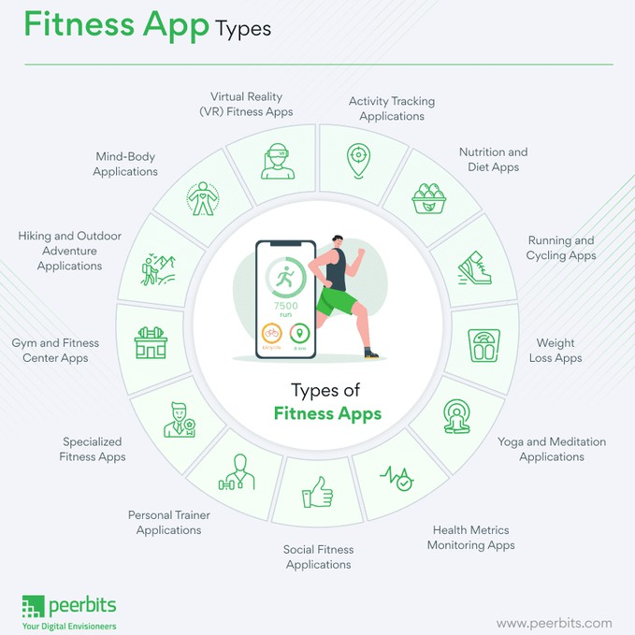
Modules
Authentication & Fitness Profile
Workout, Nutrition, Sleep Tracking
API Integration for Health Data
Health Analytics Dashboard
Health Blog & Trainer Suggestion

Slide 6
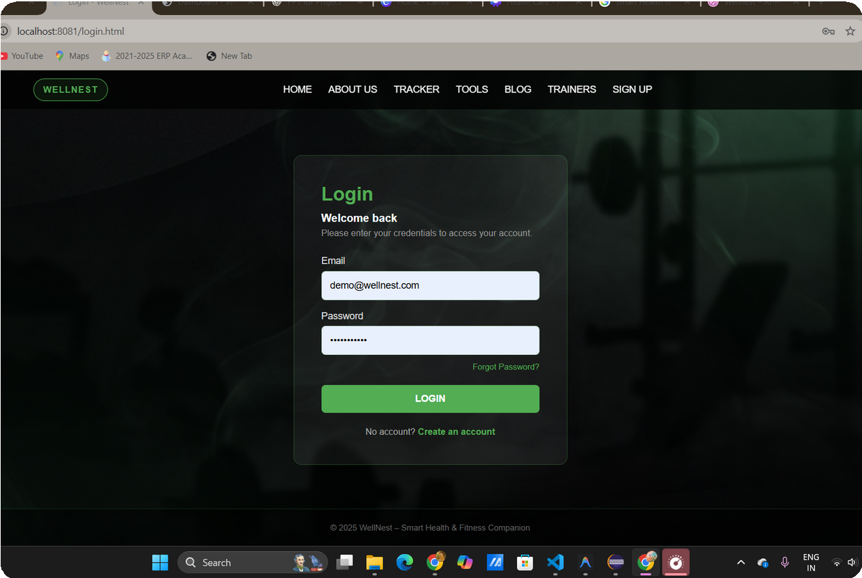
Module 1- Authentication & Fitness Profile
This module handles secure user registration and login using role-based access for users and trainers.
It also allows users to create and manage their fitness profile by entering personal details such as age, weight, and fitness goals, which are used for personalized recommendations and dashboards.
A JWT-based authentication system has been developed to handle user login and registration securely.

Slide 7
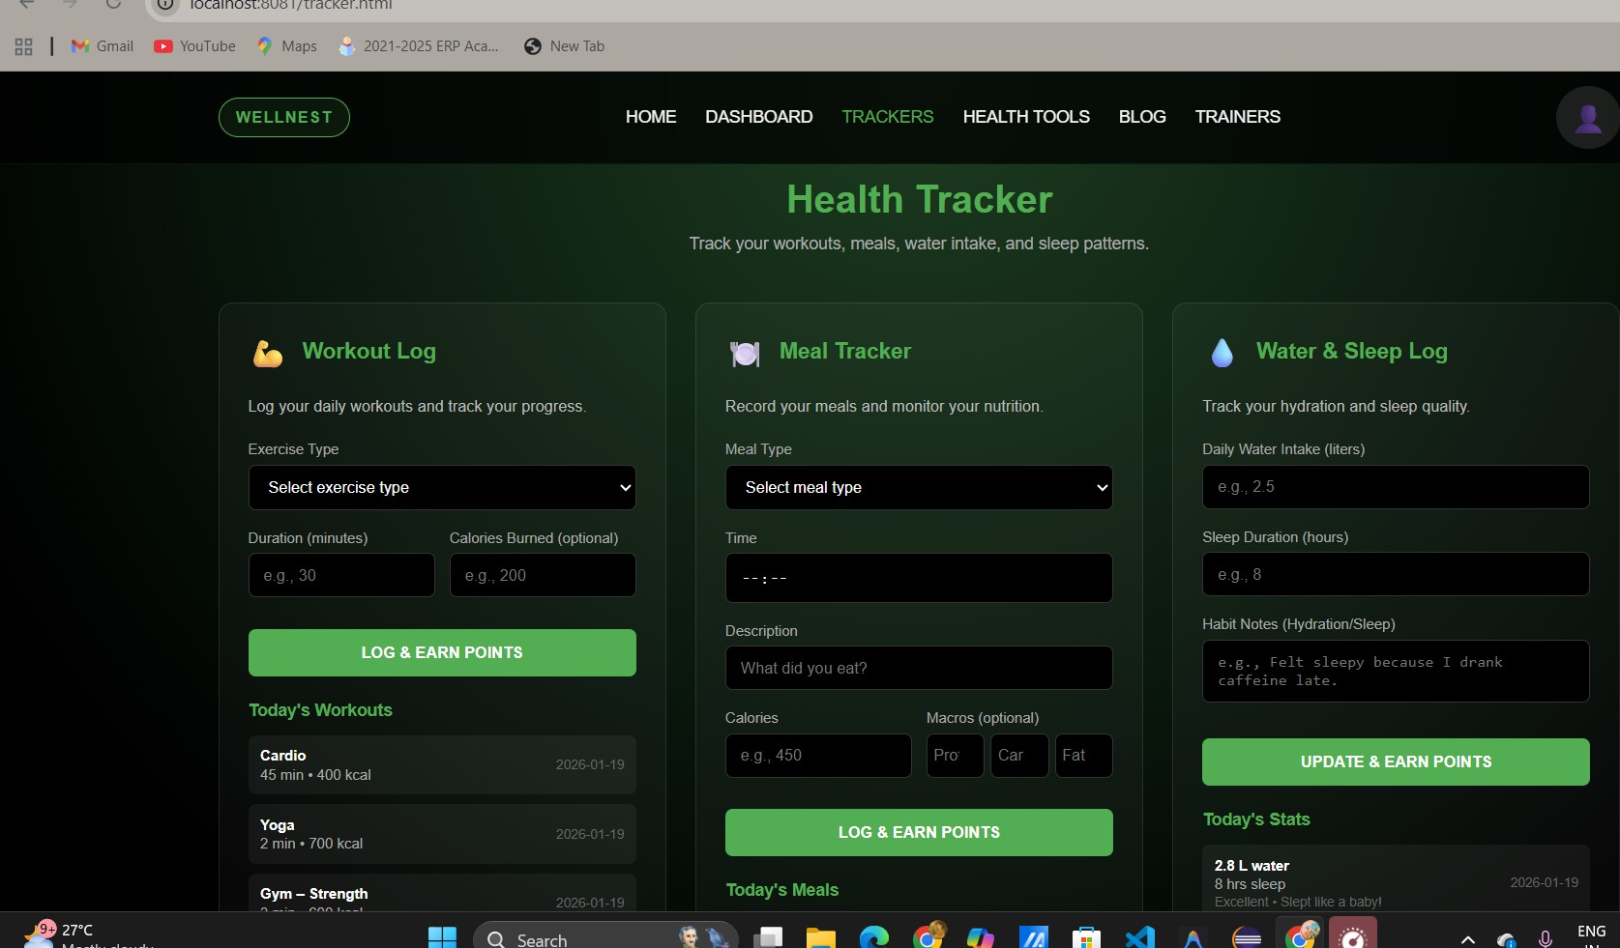
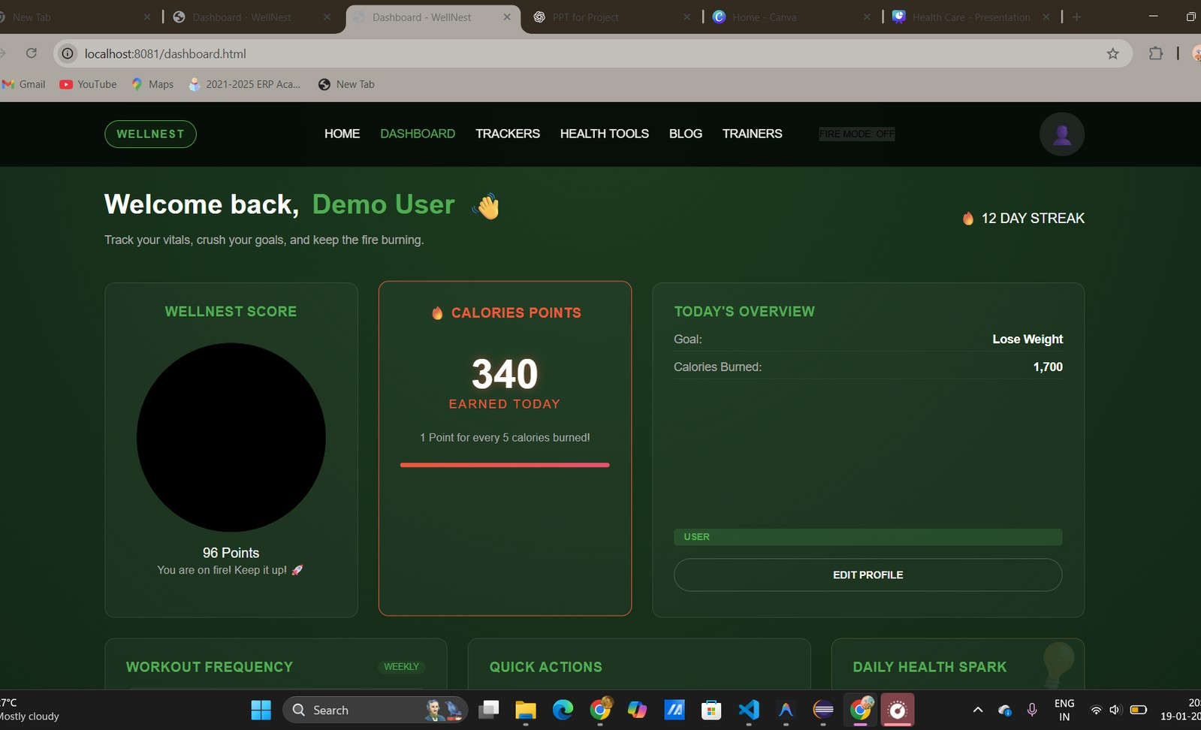
Module 2 – Workout, Nutrition & Sleep Tracking
This module allows users to record and monitor their daily workouts, meals, water intake, and sleep duration.
It helps users track their routine consistently and provides structured data for analyzing health patterns and fitness progress.

Slide 8
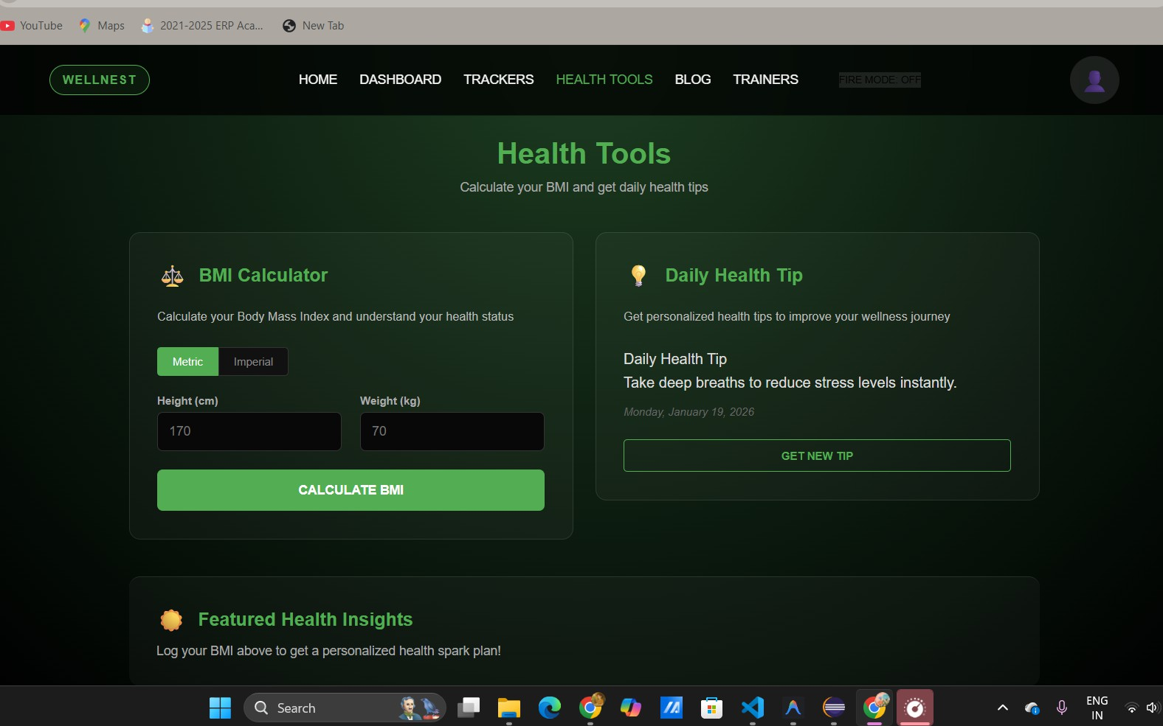
Module 3 – BMI Calculation and Health API Integration
This module integrates external and internal APIs to calculate Body Mass Index (BMI) using user profile data. It interprets in three categories:
Underweight
Normal
Overweight.
It display daily health tips.
It provides users with instant health insights and guidance based on real-time data.

Slide 9
Module 4 – Health Analytics Dashboard
This module presents user health data in the form of visual dashboards, charts, and progress indicators.
It helps users analyze workout activity, calorie balance, sleep, and water intake, enabling them to track progress toward fitness goals effectively.

Slide 10
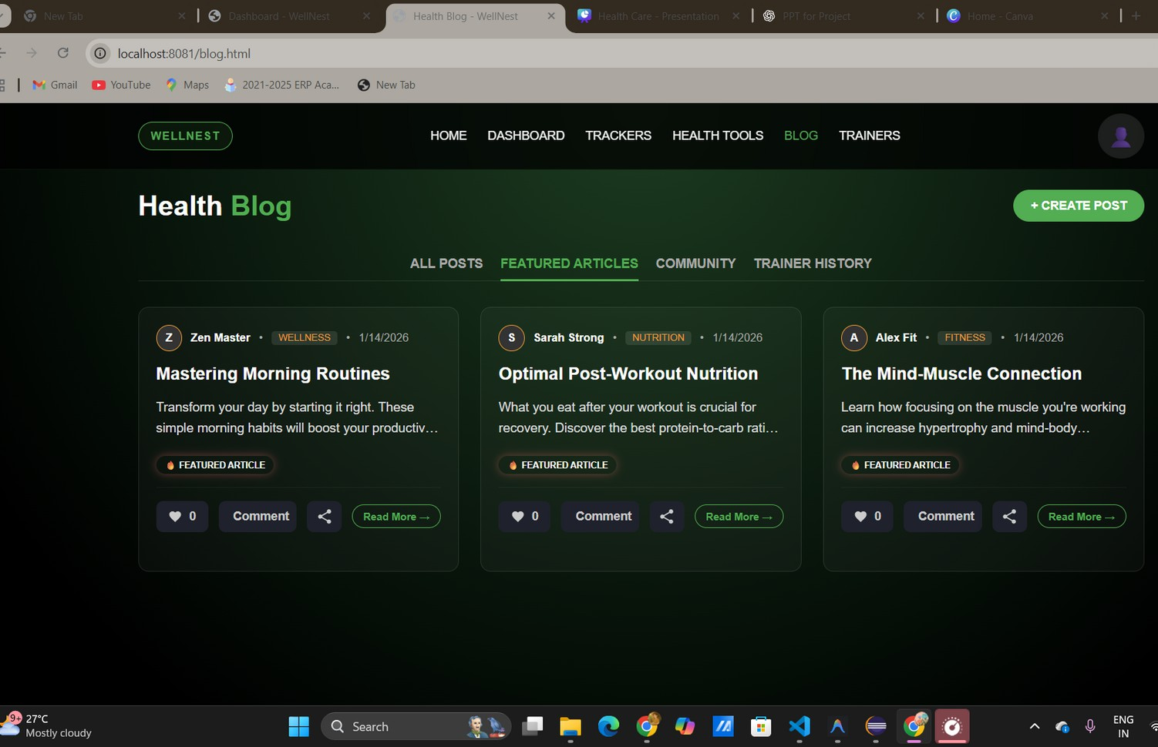
Module 5 – Health Blog & Trainer Suggestion
This module provides a health blog where users and trainers can share fitness and wellness content.
It also recommends suitable trainers based on user fitness goals, supporting guidance, motivation, and community engagement.

Slide 11
Outcome
Secured login taking care of security of user data.
Enables users to track daily health activities including workouts, meals, water intake, and sleep.
Supports role-based access with separate functionalities for users, trainers and admin for verification.
Provides BMI calculation and daily health tips through API integration. Displays visual analytics and dashboards to monitor fitness progress.
Offers personalized fitness recommendations based on user goals. Encourages healthy habits through community engagement and trainer suggestions.

Slide 12
Future Scope

Slide 13
Thank You

Slide 14
Any Questions?

